Slide 1
Local 1500 Welfare Fund Plan Review
Jan – Dec 2011

Slide 2
plan performance review
program optimization
q&a
appendix
3
5
20
21
agenda

Slide 3
plan performance review

Slide 4
plan performance review
key updates
Strategic Acquisitions
MedMetrics acquired – adds to book-of-business volume and gives additional presence in the public sector business.
PTRx acquired – high touch, data-driven model that enables client to achieve optimal mail penetration. Adds to book-of-business volume.
Both acquisitions were clients installed on our platform, streamlining integration efforts.
Notes:
4
Marketing Team to provide quarterly update/redesign of slide

Slide 5
plan performance review
key updates
Specialty Continues to Ramp
2011 YTD shows that specialty represents 0.6% of the total utilizers, but 11.6% of total plan paid
informedRx Delivers Savings and Value for Both the Plan and the Member
Sophisticated plan modeling
High touch cost-effective model
  At no extra cost to you
Multiple ways to manage cost
A no-risk proposition
Notes:
5
Marketing Team to provide quarterly update/redesign of slide

Slide 6
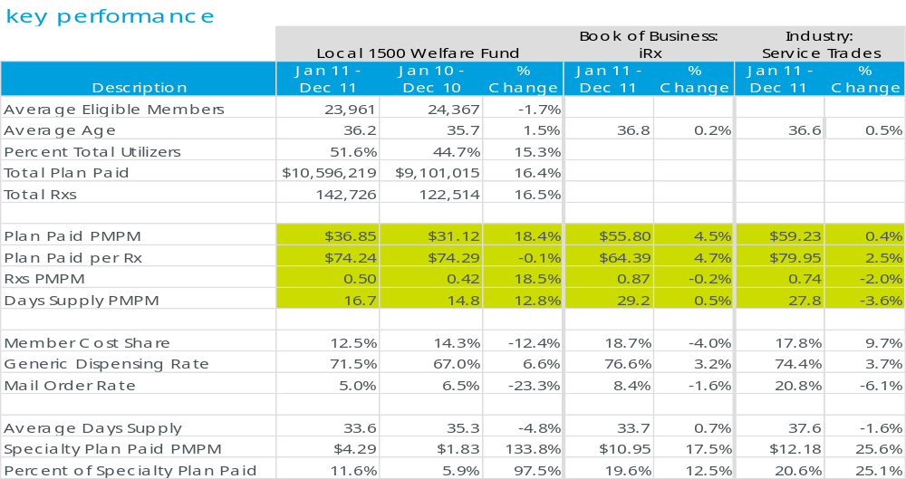
plan performance review
Key Observations:
The current PMPM trend rate for the UFCW Local 1500 fund is 18.4%. This trend was higher than the 4.5% IRx Book of Business PMPM trend and also than the 0.4% trend for the Service Trades benchmark. Contributing to the overall trend increase was the increase in the specialty trend of 133.8%.
The enrollment declined (i.e. 1.7%) but was offset by the increased in the percent of total utilizers (i.e. 15.3%). The number of prescriptions per member increased by 18.5% and the days supply PMPM increased by 12.8%.
The generic dispensing rate (GDR) increased by 6.6%. The GDR for the plan (i.e. 71.5%) is lower than both the Book of Business (i.e. 76.6%) and Service Trade Industry’s (i.e. 74.4%) GDR.
Notes:
1)Eligibility saw a decrease of 1.7%. Percent utilizers has increased by 15.3%
2) The client plan trend was 18.4%. The industry is 0.4%.
3)GDR has improved by an increase of 6.6%, it brings it closer to our BOB but there is still room for improvement.

Slide 7
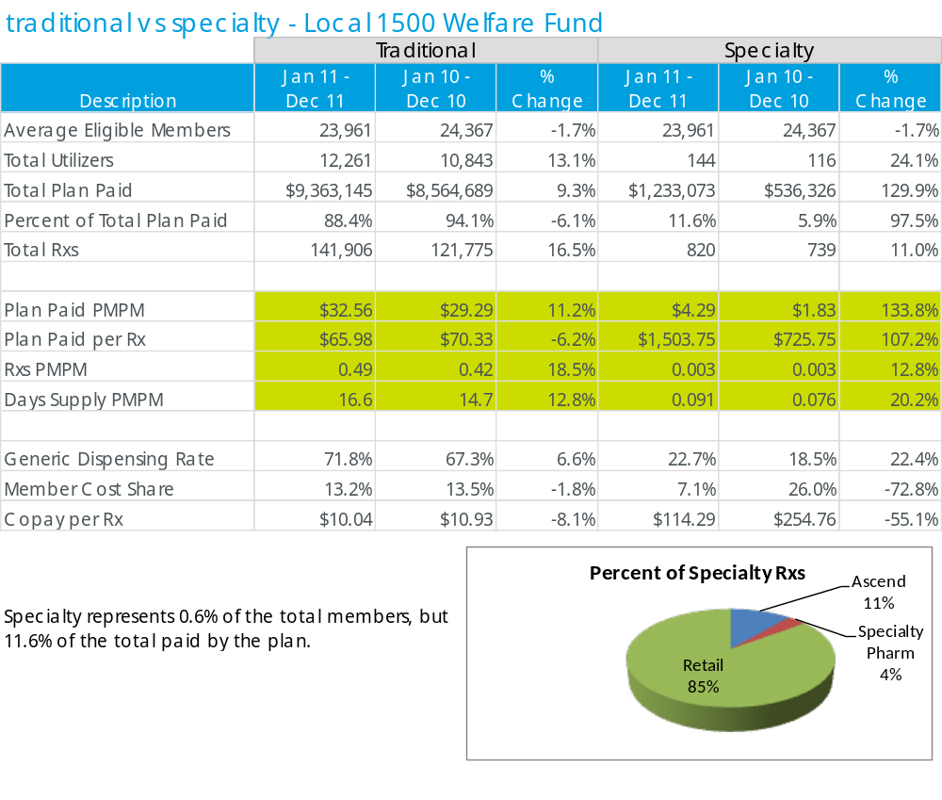
plan performance review

Slide 8
plan performance review
trend impact
trend components - Local 1500 Welfare Fund
Jan 11 - Dec 11 vs Jan 10 - Dec 10
Components of Trend
Impact of Change
Change in Plan
Service Trades:
Paid PMPM
Impact of Change
Drug Mix
-5.0%
-$1.56
-1.9%
Utilization
12.8%
$3.99
-3.6%
Inflation
8.7%
$2.71
7.8%
Plan Share
1.9%
$0.58
-1.9%
Total
18.4%
$5.73
0.4%
20.0%
18.4%
15.0%
12.8%
10.0%
8.7%
7.8%
5.0%
1.9%
0.4%
0.0%
-
Inflation
Total
1.9%
-
-5.0%
-
1.9%
-
3.6%
Plan Share
5.0%
Utilization
-10.0%
Drug Mix
Local 1500 Welfare Fund
Service Trades
1) Utilization was 12.8% there is usually an increase in utilization over time.
2) Inflation always is a contributor to trend. The drug manufacturers periodically increase drug costs of brand drugs.
3) The plan share trend has increased by 1.9%. The member cost share has decreased.

Slide 9
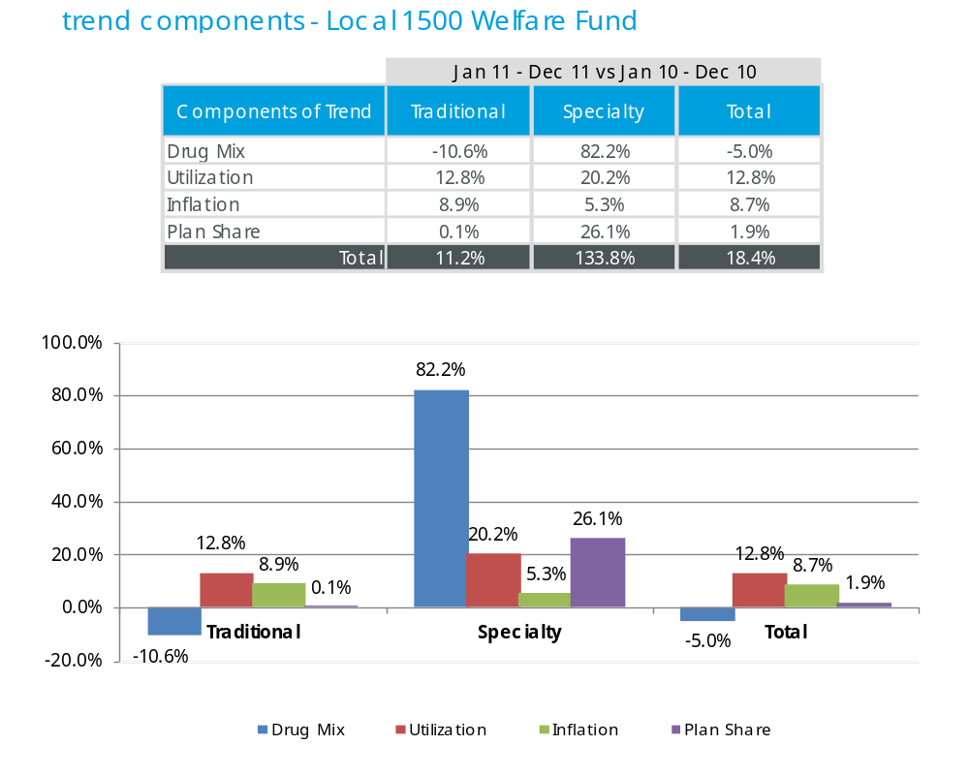
plan performance review
trend impact

Slide 10
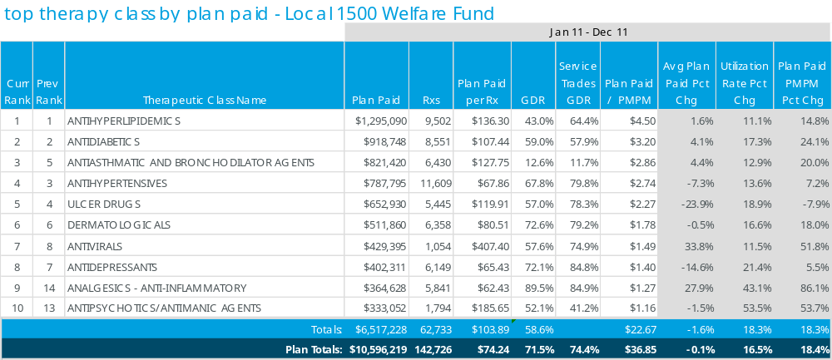
plan performance review
Key Observations:
The top therapeutic categories by plan paid represent 44.0% of the overall claims and 61.5% of the total plan spend. The trend for the top categories increase by 18.3% which is slightly lower than the overall trend of 18.4%.
Antihyperlidemics, the top therapeutic category, represent 12.2% of the total plan spend. The trend increased by 14.8% which was primarily driven by increases in both the average prescription cost (i.e. 1.6%) and the utilization rate (i.e. 11.1%). Lipitor, Crestor, Lovaza and Tricor trends increased by 7.7%, 32.7%, 24.7% and 14.3%, respectively. Additionally, the utilization for Crestor (i.e. 16.1%), Lovaza (i.e. 24.7%) and Tricor (i.e. 12.8%) increased. Lipitor is currently available as a generic product.
Antidiabetic agents, ranked number two, accounted for 8.7 % of the total plan spend. The trend for the category increased by 24.1% as a result of increases in both the average prescription costs (i.e. 4.1%) and utilization (i.e. 17.3%). The oral antidiabetic products, Actos and Januvia, trends increased by 2.6% and 21.2%, respectively.
Antiasthmatic and Broncholdilator agents represent 7.8% of the plan spend. The trend for the category increased by 20.0% which is primarily due to an increase in the trends for Advair Diskus (i.e. 12.6%), Singulair (i.e. 36.5%) and Spiriva (i.e.10.70%). Singulair is projected to be available as a generic product in May 2012.
Analgesic – Anti-Inflammatory Agents represent 3.4% of the plan spend. The trend for the category increased by 86.1% as the result of increases in the average plan paid (i.e. 27.9%) and the utilization (i.e. 43.1%). Enbrel, a self-injected specialty agent, trend increased by 48.8%. Contributing to the trend increase for Enbrel was the increase in utilization (i.e. 19.6%).
Notes:
) A little over 62% client cost is across the top 10 classes. The book of business iRx is at 54%.

Slide 11
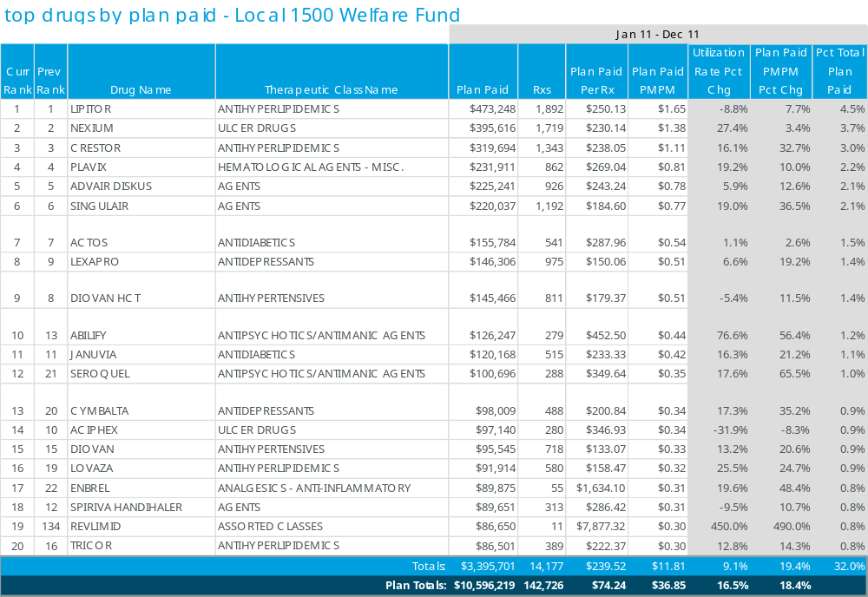
plan performance review
The top drugs by plan paid represents 9.6% of the overall claims and 32.1% of the total plan spend.

Slide 12
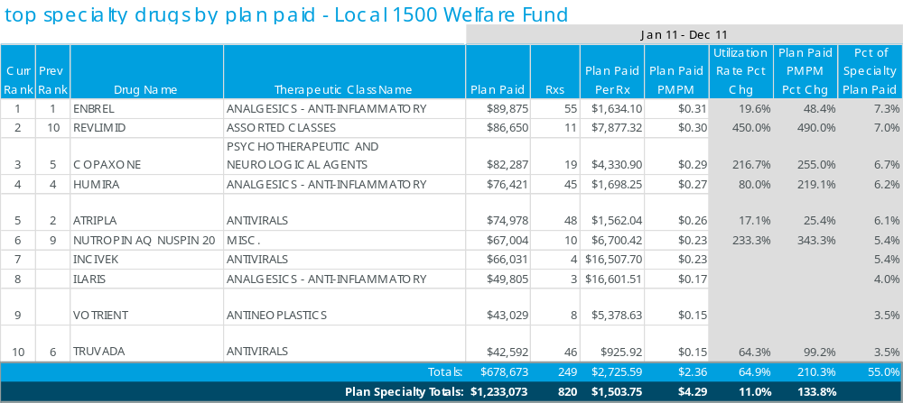
plan performance review
Key Observations:
The top specialty drugs by plan paid represent 0.6% of the overall claims and 11.6% of the total plan paid. The trend for the top specialty agents increased by 210.3% and the overall trend for specialty increased by 133.8%. The utilization of the top specialty agents increased by 64.9%.
Humira and Enbrel indicated for rheumatoid arthritis, psoriasis, and ankylosing spondylitis, represent 13.9% of the total plan paid for specialty. The utilization for both Enbrel and Humira increased by 19.6% and 80.0%, respectively. Humira is also indicated for the treatment of Crohn’s Disease. Ilaris, indicated for the treatment of Cryopyrin- Associated Periodic Syndromes (CAPS), a rare genetic disease, represents 5.3% of the total plan paid for specialty. In total the three agents represent 19.2% of the total plan paid for specialty.
Revlimid, indicated for the treatment of multiple myeloma (MM) and transfusion-dependent anemia due to low- or intermediate-1-risk myelodysplastic syndromes (MDS) associated with a deletion 5q abnormality with or without additional cytogenetic abnormalities, represents 7.0% of the total plan spend for specialty.
Copaxone, indicated for the management of multiple sclerosis (MS), represents 6.7% of the total spend for specialty products.
Atripla and Truvada, indicated for the treatment of HIV/AIDS, represent 9.5% of the total spend for specialty products. Incivek, an oral agent indicated for the treatment of Hepatitis C, represents 5.4% of the total spend for specialty. The Antiviral category represents 14.9% of the total spend for specialty.
Nutropin, a growth hormone product, represents 5.4% of the total specialty spend.
Votrient, indicated for the treatment of advanced renal cell carcinoma, represents 3.5% of the total spend for specialty.

Slide 13
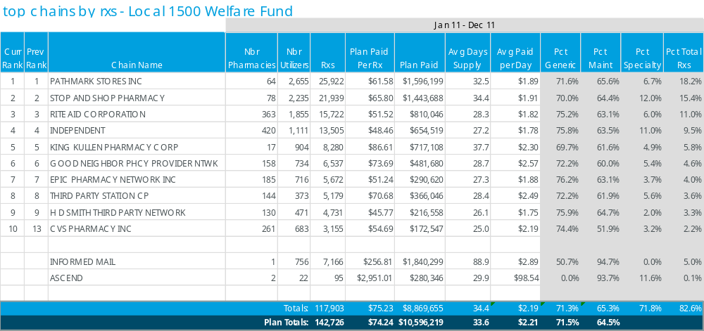
plan performance review

Slide 14
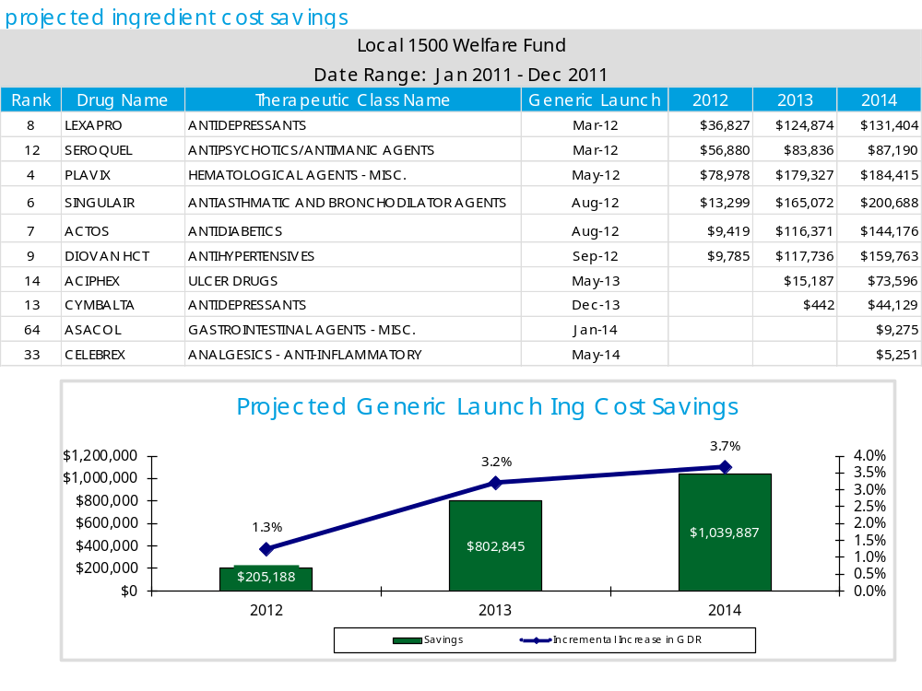
plan performance review

Slide 15
program optimization

Slide 16
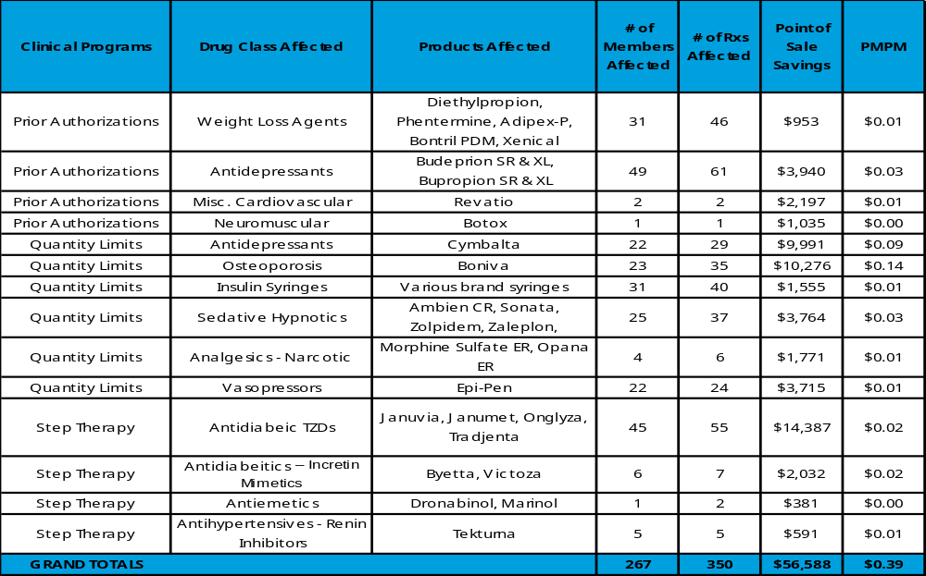
Clinical management outcomes - utilization management savings report
Notes:
Qnexa® (phentermine and topiramate) Extended-release Capsules is an investigational, once-per-day, weight-loss therapy that combines low doses of two agents approved by the Food and Drug Administration (FDA), phentermine and topiramate, in a controlled-release formulation.

Slide 17
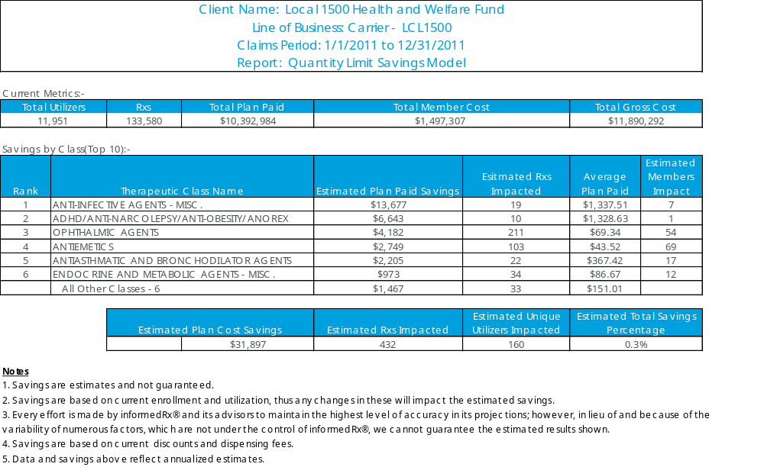
program optimization Cost Model for Additional Quantity limits
Notes:
Additional QL are for the PDE-5 inhibitors and triptans.

Slide 18
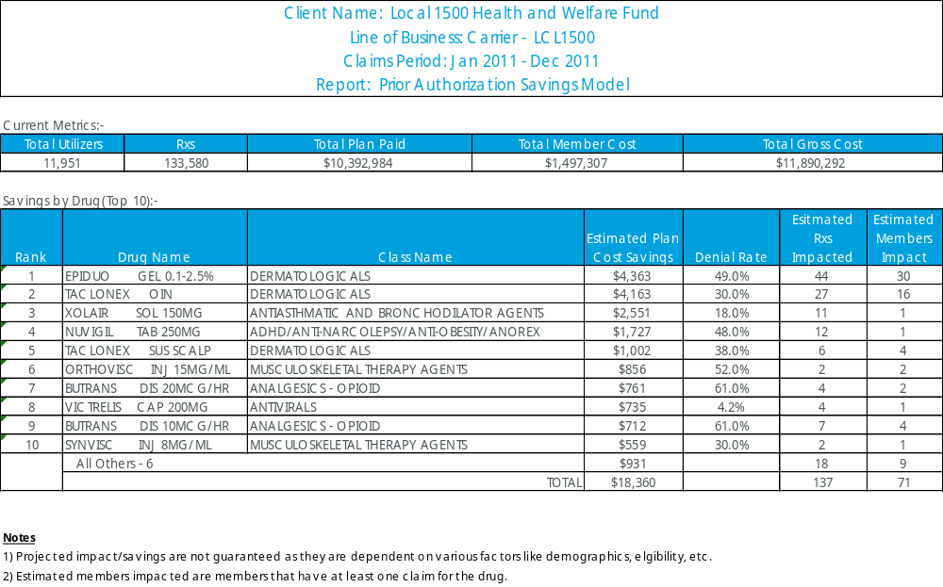
program optimization Cost Modeling for Additional Prior Authorizations

Slide 19
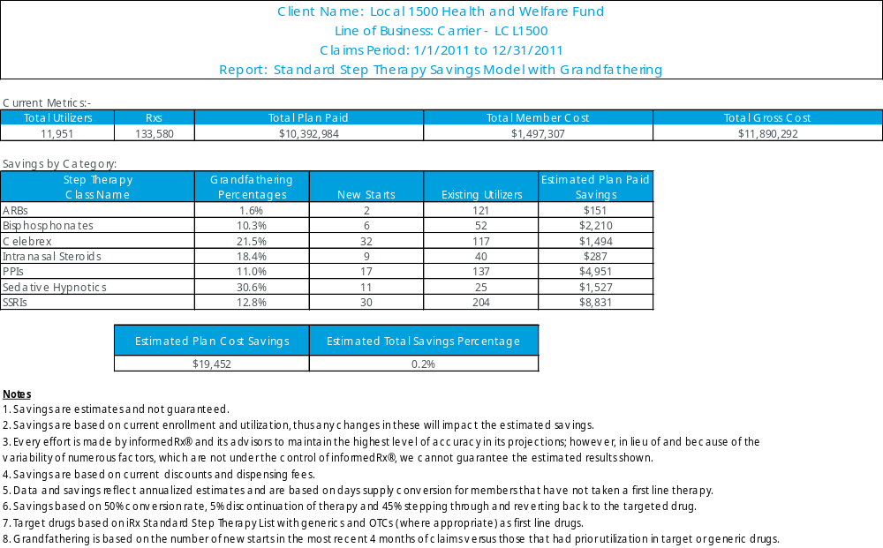
program optimization Cost Modeling for Additional Step Edits

Slide 20
Q & A

Slide 21
appendix

Slide 22
plan performance review
Trends
2011 Market Highlights
From 2009 to 2010 total U.S. drug expenditures increased by 2.7%
  Total drug spend increased from $299.2 billion to $307.5 billion
The Food and Drug Administration (FDA) approved 35 innovative drugs for FY October 1, 2010 through September 30, 2011
  Seven drugs (20.0%) were for cancer treatment
  10 agents (28.6%) were for rare (orphan) diseases which there were either no treatments or few treatments
  Other agents of note:
    Two new oral treatments for Hepatitis C
      Victrelis
      Incivek
    Cardiovascular and stroke prevention
      Pradexa
      Bilinta
  GDR was affected by the first time generic approvals of the following drugs:
    Cardiovascular agents: Lipitor and Caduet
    CNS: Zyprexa, Ritalin LA, Concerta, and Lunesta
    Allergy: Nasocort AQ
      This is a partial list

Slide 23
plan performance review
2012 Trends
2012 Potential Market Trends
It is estimated that there will be a 3 to 5% increase in total drug expenditures across all settings. In part driven by:
  New drugs approvals
  Increased specialty drug utilization
  Disease trends:
    Oncology drugs will likely become the second or third driving trend by 2015
    The epidemic of obesity and unhealthy life choices resulting in an increase in the prevalence of chronic diseases such as, diabetes and cardiovascular disease
Generic Drug Approvals
  It is likely by the end of 2013 the GDR for high-cost categories such as statins, PPI, triptans and allergy medications, could reach 80 to 90%
Biosimilar Drugs authorization
  Part of the Affordable Health Care Act
Over-the-Counter Conversions
Drug Shortages

Slide 24
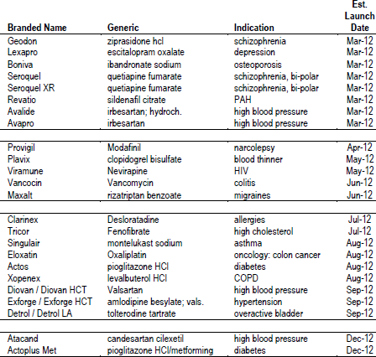
2012 Generic Drug Launches

Slide 25
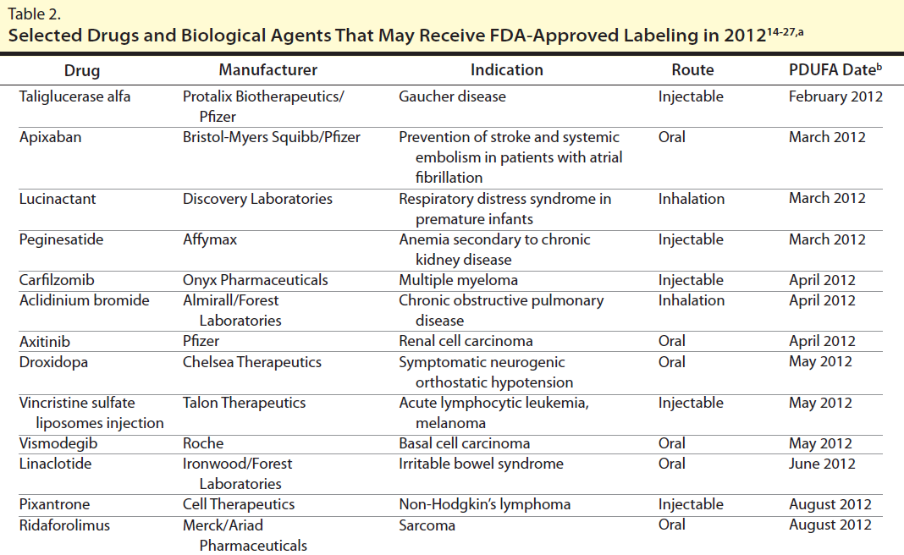

Slide 26
appendix
therapeutic classification descriptions
Drug group | Drug group name | Description
05 | Fluoroquinolones* | Agents for treating infections such as respiratory tract and urinary tract infections
12 | Antivirals* | Agents for treating viral infections such as influenza, hepatitis C, and HIV
21 | Antineoplastics* | Agents used in treatment of cancer
24 | Estrogens* | Oral, topical and miscellaneous formulations used for estrogen replacement
25 | Contraceptives* | Includes oral, vaginal and other formulations
27 | Antidiabetics* | Includes oral and injectable agents to treat diabetes
30 | Endocrine and metabolic agents - misc.* | Includes osteoporosis agents, fertility agents, growth hormones and other miscellaneous endocrine and metabolic agents
34 | Calcium channel blockers* | Agents used for treatment of hypertension and other cardiovascular disorders
36 | Antihypertensives* | Agents used for treatment of hypertension excluding beta blockers, calcium channel blockers and diuretics
39 | Antihyperlipidemics* | Cholesterol lowering agents including statins and other miscellaneous agents
40 | Cardiovascular agents - misc.* | Agents for treatment of pulmonary hypertension, erectile dysfunction and miscellaneous combination and other cardiovascular products
41 | Antihistamines* | Includes non-sedating antihistamines and other antihistamines
42 | Nasal agents - systemic and topical* | Includes decongestants and nasal sprays
44 | Antiasthmatic and bronchodilator agents* | Agents for treatment of asthma and COPD
49 | Ulcer drugs* | Includes ppis (e.G., Nexium) and other miscellaneous agents for prevention or treatment of ulcers

Slide 27
appendix
therapeutic classification descriptions (continued)
Drug Group | Drug Group Name | Description
50 | ANTIEMETICS* | Agents for prevention or treatment of nausea and vomiting
58 | ANTIDEPRESSANTS* | Includes SSRIs (e.g., Lexapro), SNRIs (e.g., Cymbalta and Effexor XR) and other miscellaneous antidepressants
59 | ANTIPSYCHOTICS/ANTIMANIC AGENTS* | Includes atypical antipsychotics (e.g., Abilify), older antipsychotics and antimanic agents (e.g., Lithium)
60 | HYPNOTICS* | Includes drugs for insomnia (e.g., Ambien) and miscellaneous hypnotics
65 | ANALGESICS - OPIOID* | Narcotic pain medications (e.g., OxyContin and Tylenol with Codeine)
66 | ANALGESICS - ANTI-INFLAMMATORY* | Includes specialty (e.g., Enbrel, Humira) and non-specialty anti-inflammatory agents (e.g., NSAIDs and Celebrex)
67 | MIGRAINE PRODUCTS* | Agents for prevention and treatment of migraines including triptans (e.g., Imitrex, Maxalt)
72 | ANTICONVULSANTS* | Includes agents for seizure disorders and nerve-related pain (e.g., gabapentin, Lyrica, topiramate)
75 | MUSCULOSKELETAL THERAPY AGENTS* | Includes products such as muscle relaxants (e.g., Skelaxin) and viscosupplements (e.g., Orthovisc and Synvisc)
85 | HEMATOLOGICAL AGENTS - MISC.* | Includes products such as hemophilia Factors and platelet aggregation inhibitors (e.g., Plavix and Effient)
90 | DERMATOLOGICALS* | Topical agents including acne products, anti-infectives, anti-psoriatics and corticosteroids
94 | DIAGNOSTIC PRODUCTS* | Includes diabetes blood glucose meters and test strips and miscellaneous diagnostic products
99 | ASSORTED CLASSES* | Miscellaneous non-specialty and specialty products including immunosuppressive agents (to prevent organ transplant rejection), immunomodulators and monoclonal antibodies

Slide 28
appendix
report calculations & assumptions
Name | Definition | Calculation
Ave Eligible Members | Monthly average members who are inrolled in a plan | total eligibility per year / total number of months(12)
utilizing member % | Percent of members who utilize at least one Rx per month
Plan Paid PMPM | Total Plan Paid per Member Per Month | Total Plan Paid/Average Eligibles / # of Months
Average Rx Cost | Plan Paid amount per Rx | Total Plan Paid/Total # of Rxs
Rxs PMPM | Ave Rxs per Member per Month | Total # of Rxs/Average Eligibles/# of Months
Member Paid % | Member Paid amount in relation to the total drug cost | Total Member Paid/Total Drug Cost
Generic Dispensing Rate | Total Number of Generic Claims Dispensed in relation to overall claims | # of Generic Claims / # of Total Rxs
Mail Order Rate | Number of Rxs in relation to total number of Rxs dispensed at mail | # of mail Rxs / total # of Rxs
Average Days Supply | Average days filled per Rx | Total # of Days / Total # of Rxs
Specialty Plan Paid PMPM | Total Plan Paid in Specialty per Member per Month | Total Plan Paid / Average Eligibles / # of Months
% of Plan Spend Specialty | Total Plan Paid amount in Specialty in relation to Total Drug Cost | Plan paid / Total Drug Cost (Specialty)
Drug Mix | Proportion of Brand vs. Generic Rxs filled at retail and mail | Drug Mix = Plan Trend - (Utilization Trend + Price / Inflation Trend)
Utilization | % Change in total days supply per member per month | (Days Supply PMPM Period 2 - Days Supply PMPM Period 1) / Days Supply PMPM Period 1
Plan Cost Share | % Change in total plan paid year over year | ((Plan Cost Period 2 / Total Drug Cost Period 2) - (Plan Cost Period 1 / Total Drug Cost Period 1) / (Plan Cost Period 1 / Total Drug Cost Period 1))
Price / Inflation | % Change in Total Drug Cost for the same drugs on a GPI14 level and a generic indicator year over year | (Adj Total Drug Cost Period 2 - Adj Total Drug Cost Period 1) / Adj Total Drug Cost Period 1
Plan Trend | % Change in Plan Paid per member per month year over year | (Plan Paid PMPM Period 2 - Plan Paid PMPM Period 1) / Plan Paid PMPM Period 1

